Slide 1
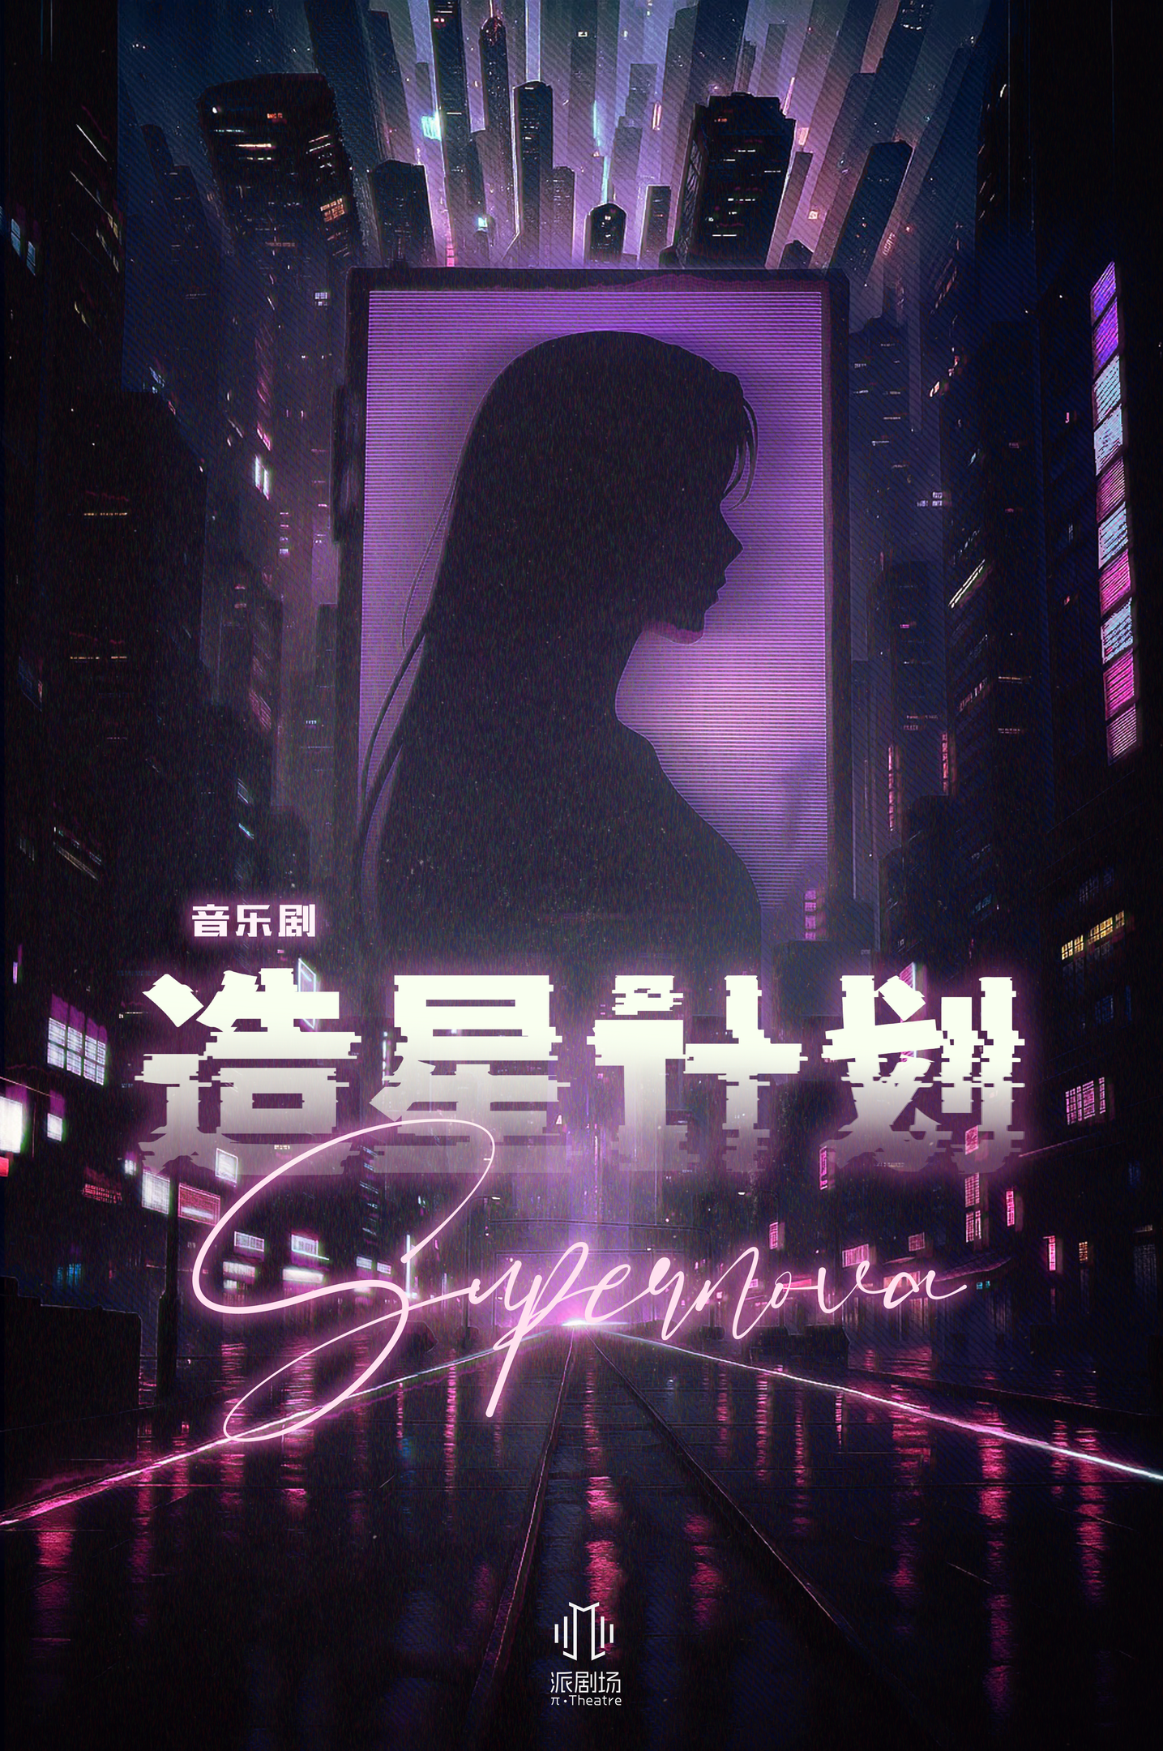
Supernova
An Original Musical
Executively Produced by Miller Mi

Slide 2
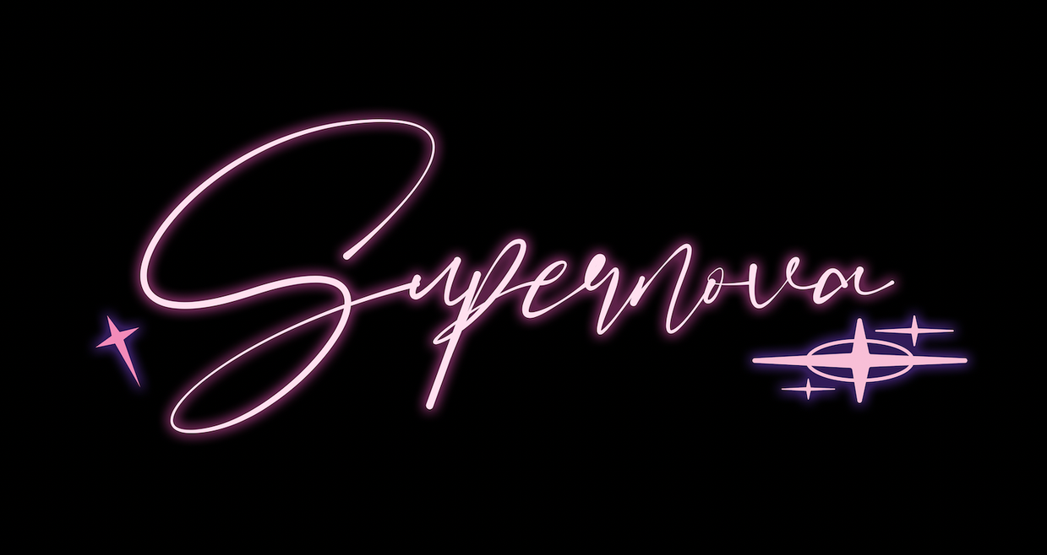
Opened in December 2025, Shanghai
26
performances in the first round
9.9
Rating on Damai
4000+
audience
3.7M+
views and discussions across social media
¥1,000,000+
at the box office

Slide 3
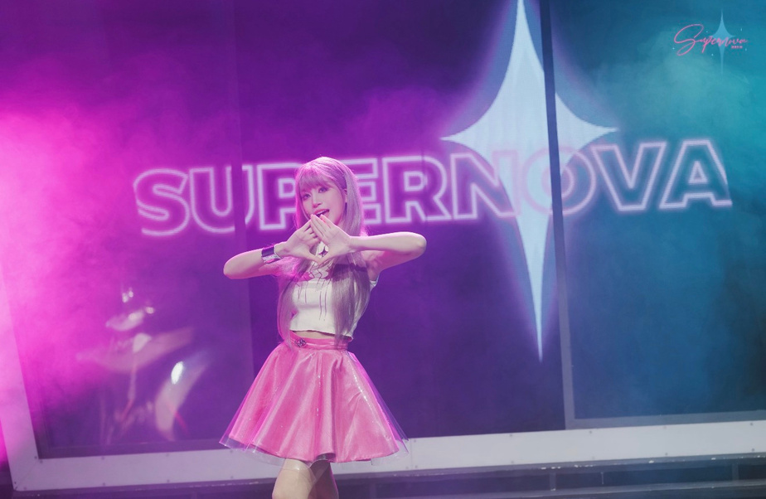
Synopsis
Cyber Era, Year 21. Angel City—where virtual reality reigns supreme, and where the Supernova Project, held once a decade, shapes society's collective consciousness. "LIKE" has replaced traditional currency. As a new competition begins, desperate girls flock to Angel City, hoping to buy their dream lives with supporters' LIKEs and achieve the same upward mobility as Angel, the reigning champion. Aria—a "manufactured star" trained from birth to be the perfect idol—is unexpectedly paired with Brianna, a "wild soul" from reality's ruins who entered the competition searching for her missing mother. One strategizes every move for victory while the other chases truth without caution. Their partnership ignites unexpected feelings and accidentally exposes the dark secret behind the first champion's disappearance—and the brutal reality beneath the system's "perfect" facade. Will their final choice become another calculated move in the system's game, or the spark that ignites rebellion?

Slide 4
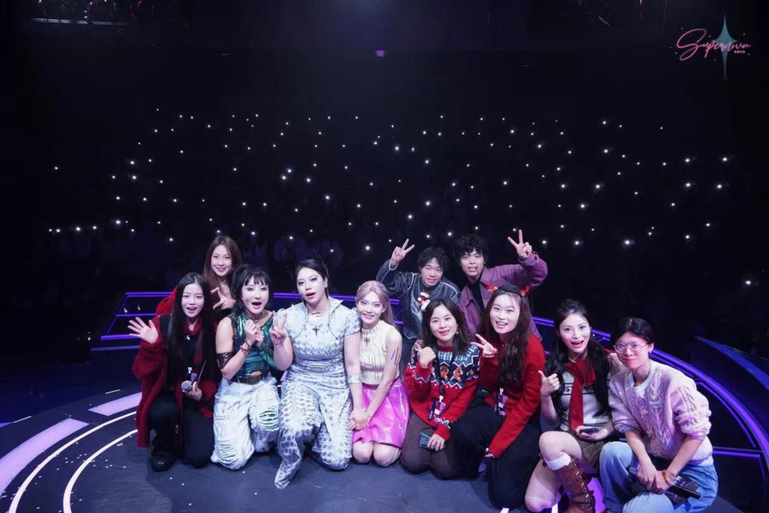
Role Description
As the producer of this original commercial musical, I led the project through every stage of development and execution, from initial concept workshops to final performance. I spearheaded fundraising initiatives to secure the necessary capital, developed and implemented comprehensive marketing campaigns to build audience awareness, and oversaw all production operations to ensure smooth technical and creative execution. My role required directing collaboration across multiple departments: I coordinated between writers, designers, and directors on the creative side while simultaneously managing relationships with financial advisors, marketing teams, and venue operators on the business side. I facilitated regular communication between different units, ensuring that design timelines aligned with budget constraints, that marketing materials accurately reflected creative content, and that technical capabilities supported artistic ambitions. Throughout the production process, I maintained oversight of scheduling, budget allocation, vendor negotiations, and quality control across all departments. This hands-on approach to producing—simultaneously managing creative development, financial planning, and operational logistics—resulted in the production successfully reaching 1,000,000 RMB at the box office, demonstrating effective execution across all phases of bringing new theatrical work from page to stage.

Slide 5
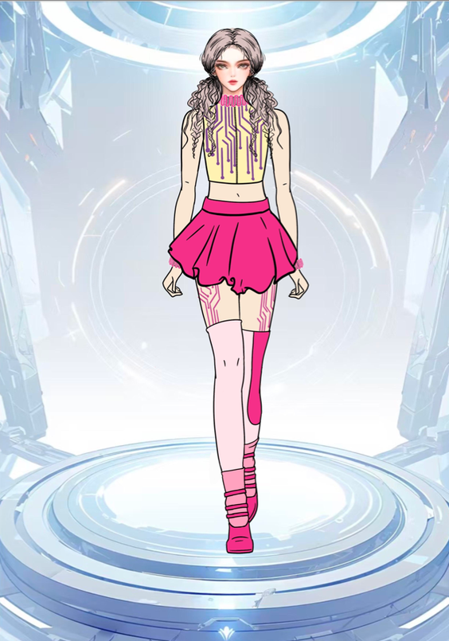


Costumes

Slide 6




Slide 7
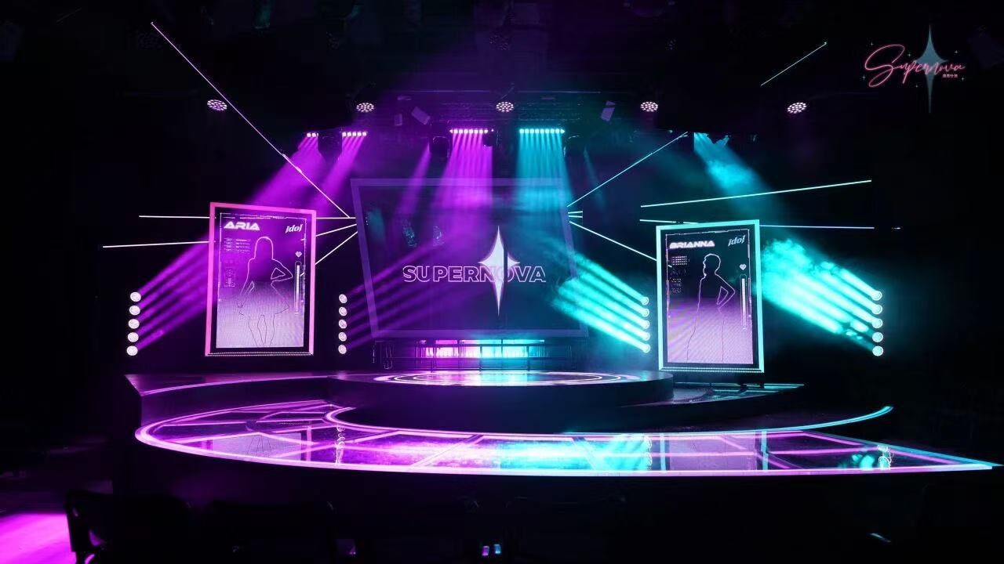
Set Design

Slide 8
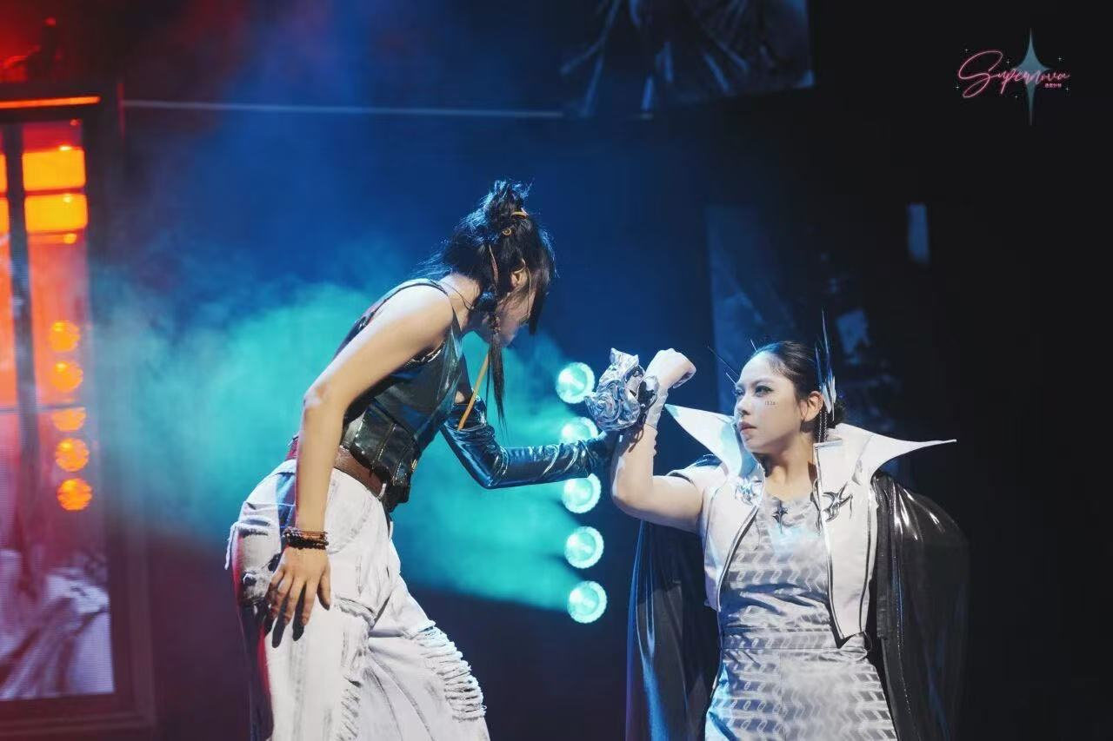

Slide 9
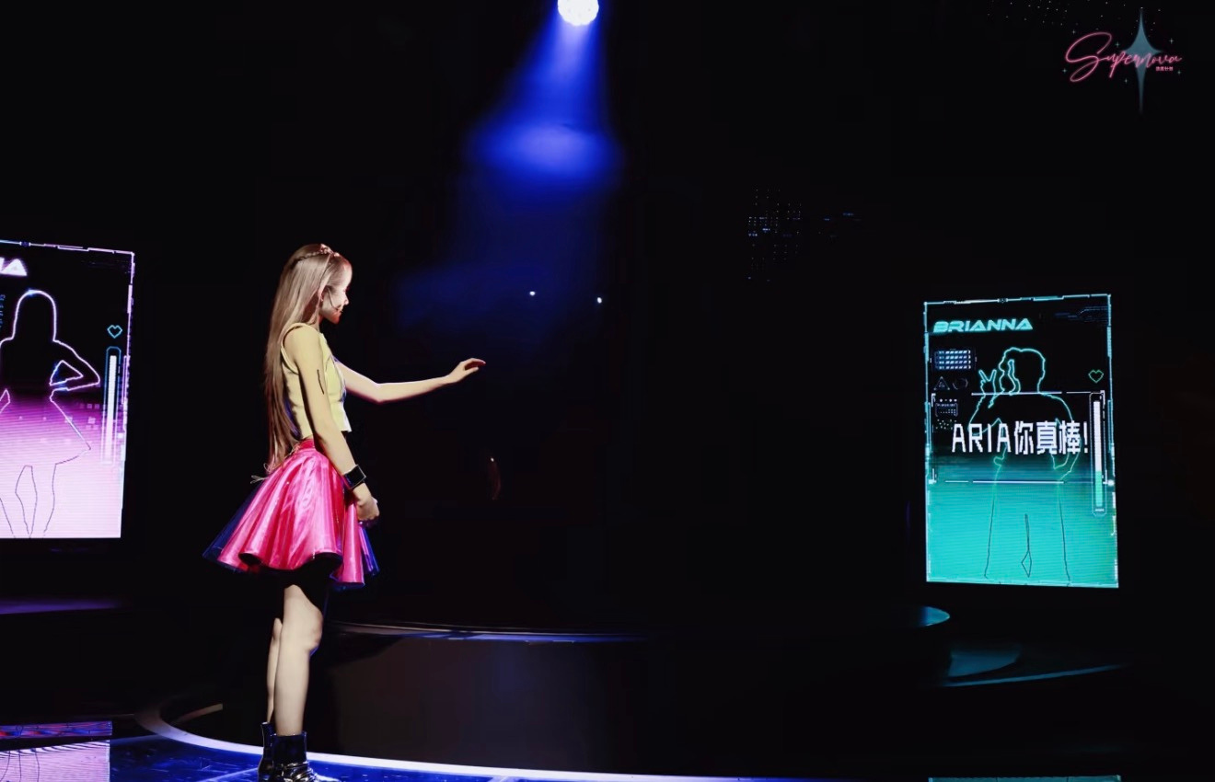

Slide 10
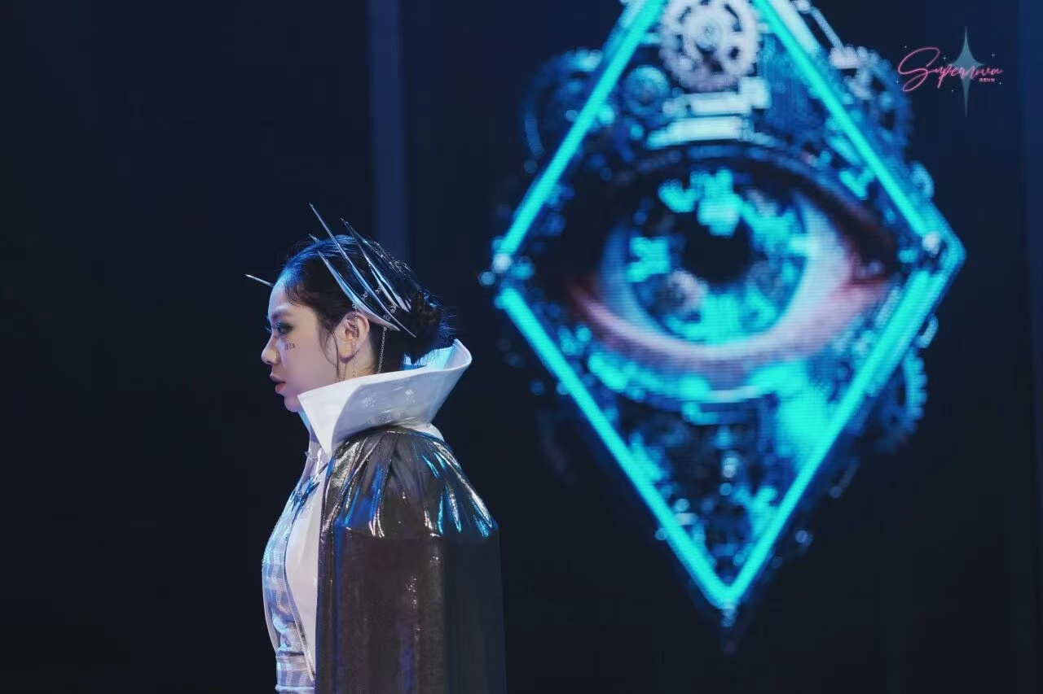

Slide 11

Video Recording

